Slide 1


Slide 2
Phishing Attack

Slide 3
INTRODUCTION
Presented by :
Muhammad Nadeem
Ayesha Ashfaq
Sadia Saeed Baig
Uzba
Abdul Wahhab
Submitted to :
Sir Aleem Awan

Slide 4
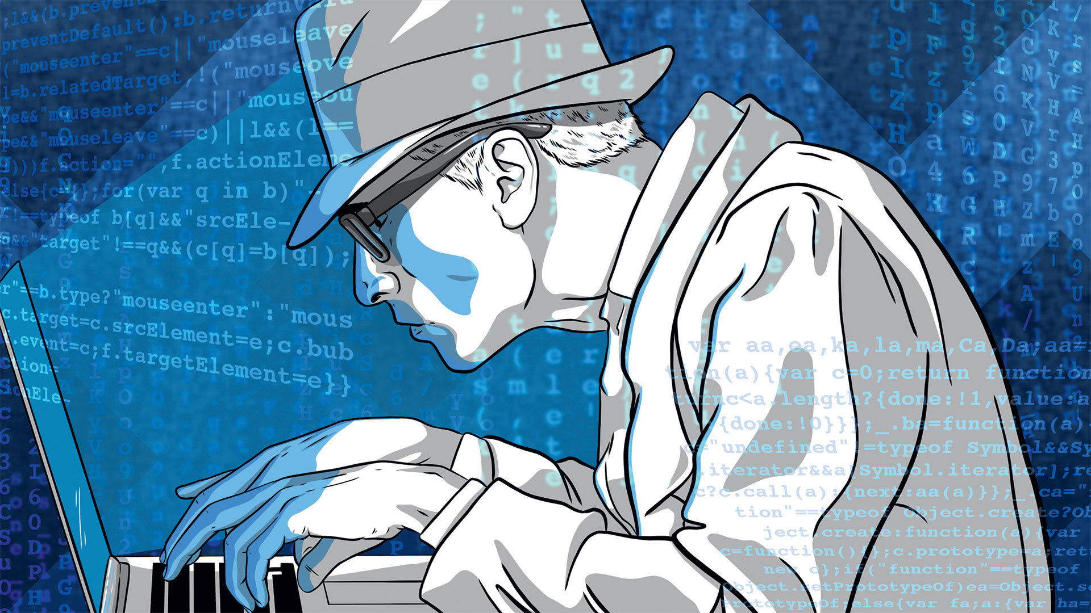
CONTENT
Introduction
History
Types of Phishing
Tools and Procedure
How phishing looks like?
Prevention
Conclusion

Slide 5
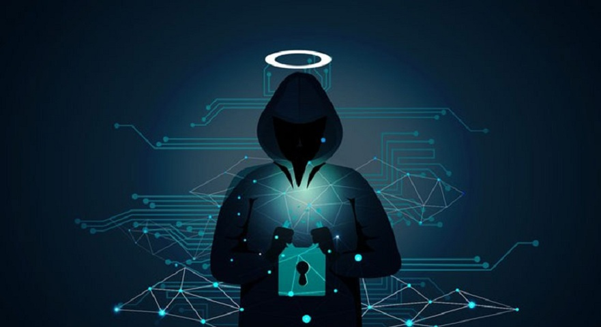
Phishing:
Attacker masquerading as trustworthy entity dupes/tricks the user into opening an email or text message and clicking a link, thus revealing its sensitive information.
Why its called phishing ? Basically the hacker fishes a user’s data from a sea of users or data.

Slide 6
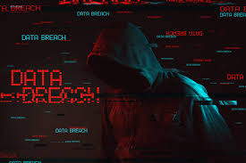
History:
1st Attack:
The term phishing and its concept can be traced back to the 90s through America Online (AOL) --> Internet Service Provider. A group of hackers called themselves as “warez community”. This group is also known as “the first phishers”.
2nd Attack
Even though the attempt was unsuccessful, the first known phishing attack on Ecommerce websites started with E-Gold website on June 2001.

Slide 7
History:
3rd Attack:
By 2003, hackers went onto register several new domains that resembled names of popular sites
4th Attack:
By early 2004, phishing evolved into a profitable business and hackers started attacking banks, enterprises, and their customers..

Slide 8
Types of phishing
Email Phishing
Vishing
Spear Phishing
Whaling
Smishing

Slide 9
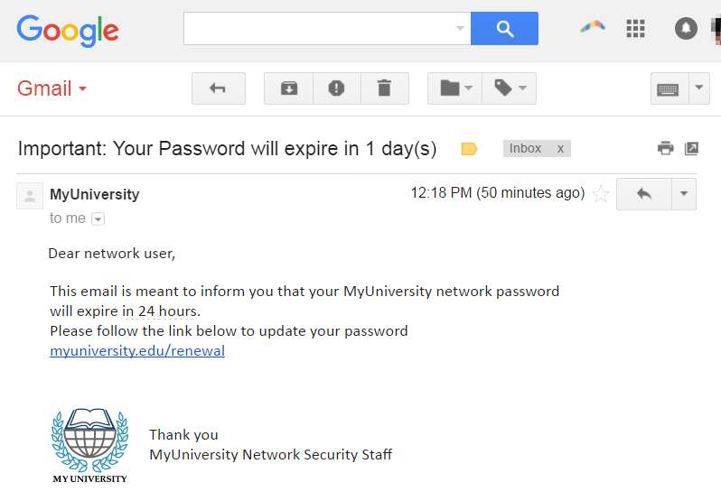
Email Phishing :
The most common form of attack where the attacker appears as legitimize organization attempts to steal sensisitve information via email address.Not a target attack but is usually done on mass scale.

Slide 10
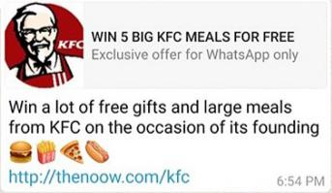
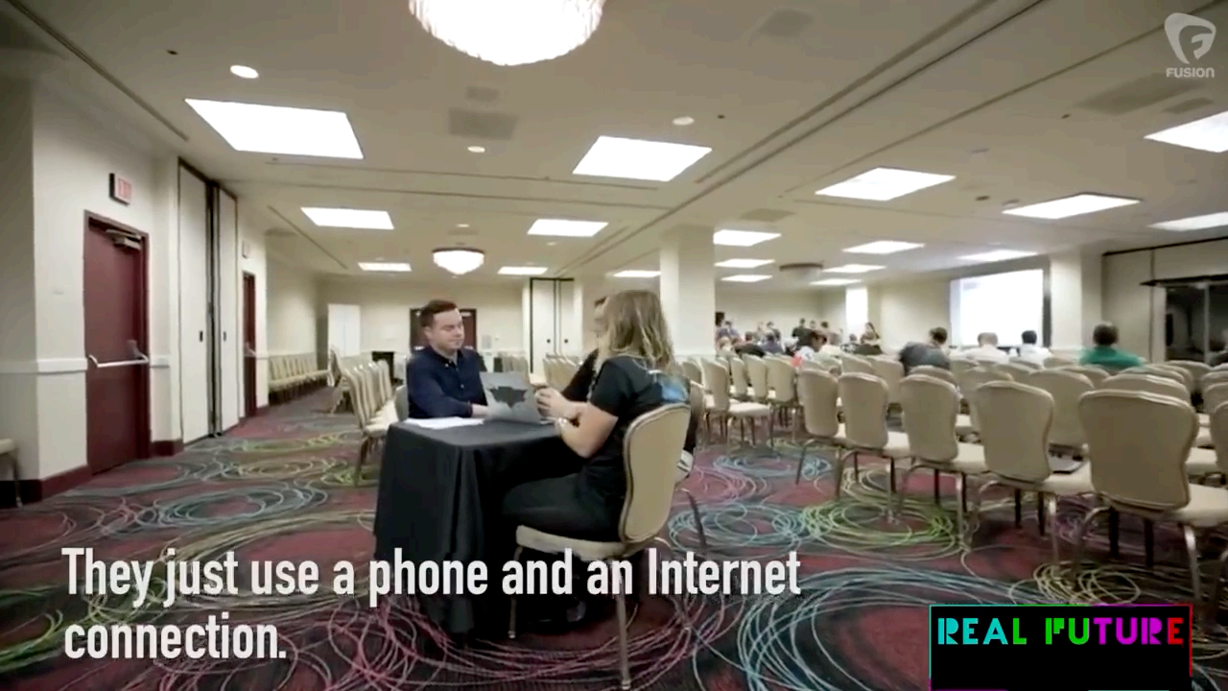
Smishing:
Sms or text messsage based attack sent to the user as a link to a malicious webiste (where user is asked to enter information) or to install a malware.
Vishing:
A vishing attack is a type of scam in which criminals contact a potential victim over the phone pretending to be a company and try to convince them to share personal information.

Slide 11
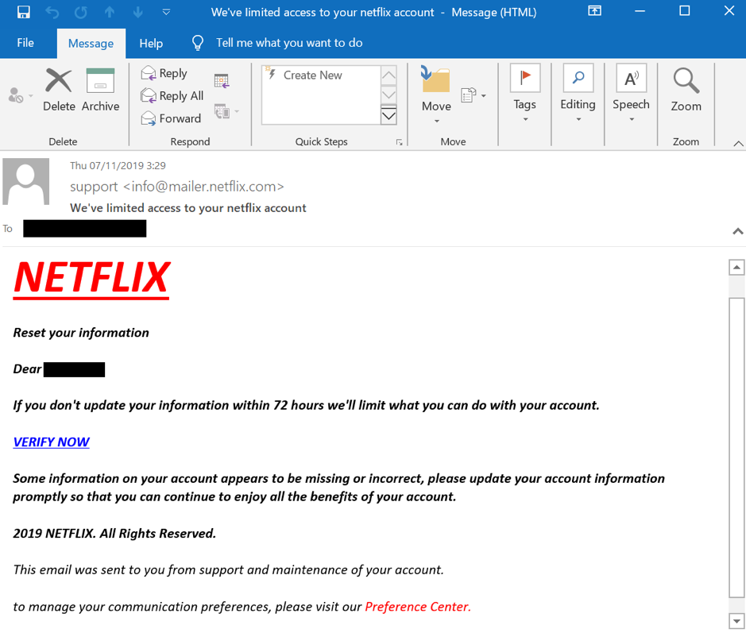
Spear Phishing :
Targeted attack directed at specific individuals or companies using gathered information to personalize the message and make the scam more difficult to detect .

Slide 12
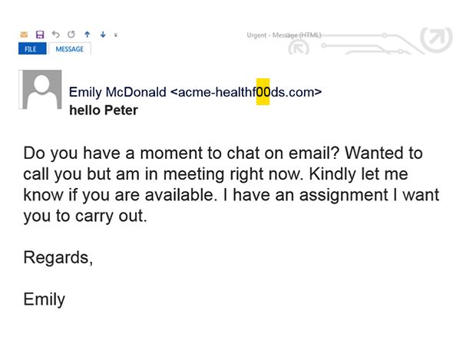
Whaling:
Type of spear phishing attack that targets “big fish,” including high-profile individuals or those with a great deal of authority or access

Slide 13
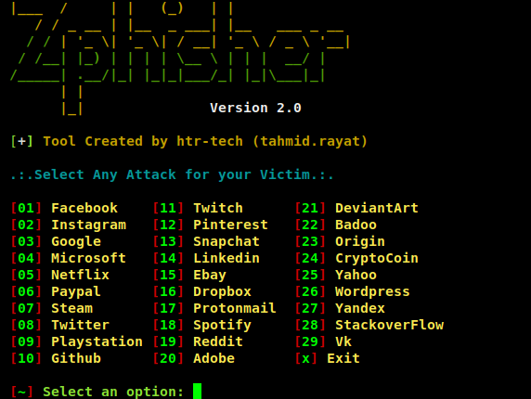

Tools used for Phishing:
Kali Linux as the OS:
Zphisher
VMware Workstation 16 Player

Slide 14
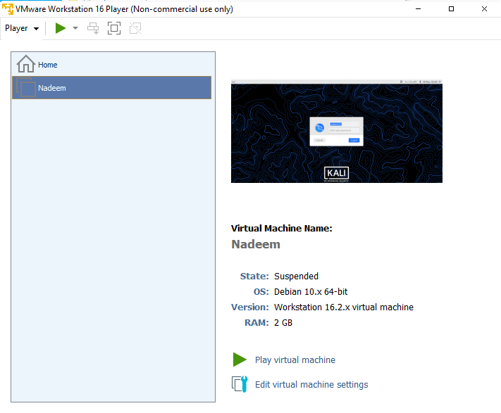

Slide 15
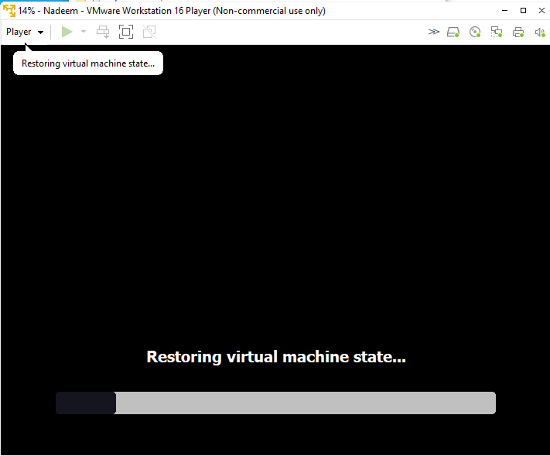

Slide 16
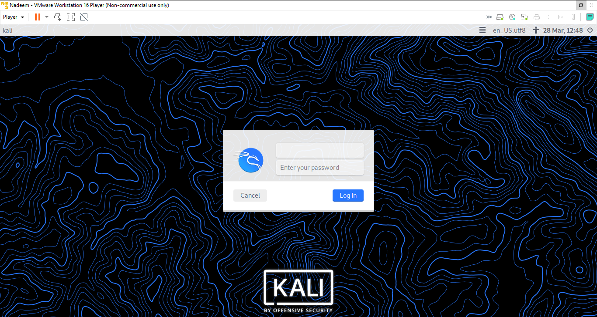

Slide 17
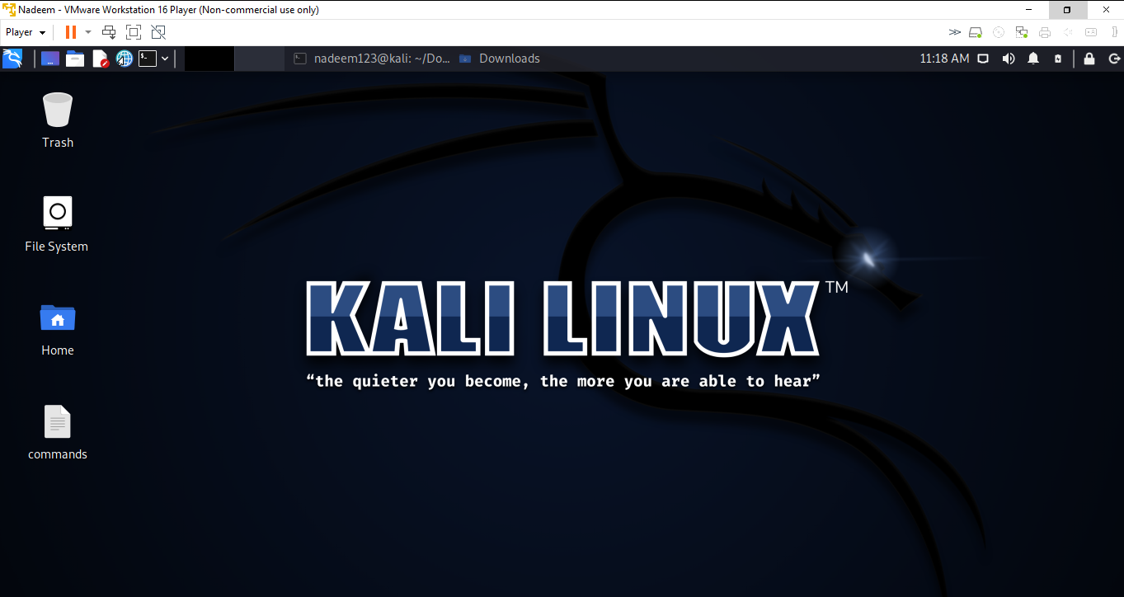
Procedure
Kali Linux Interface

Slide 18
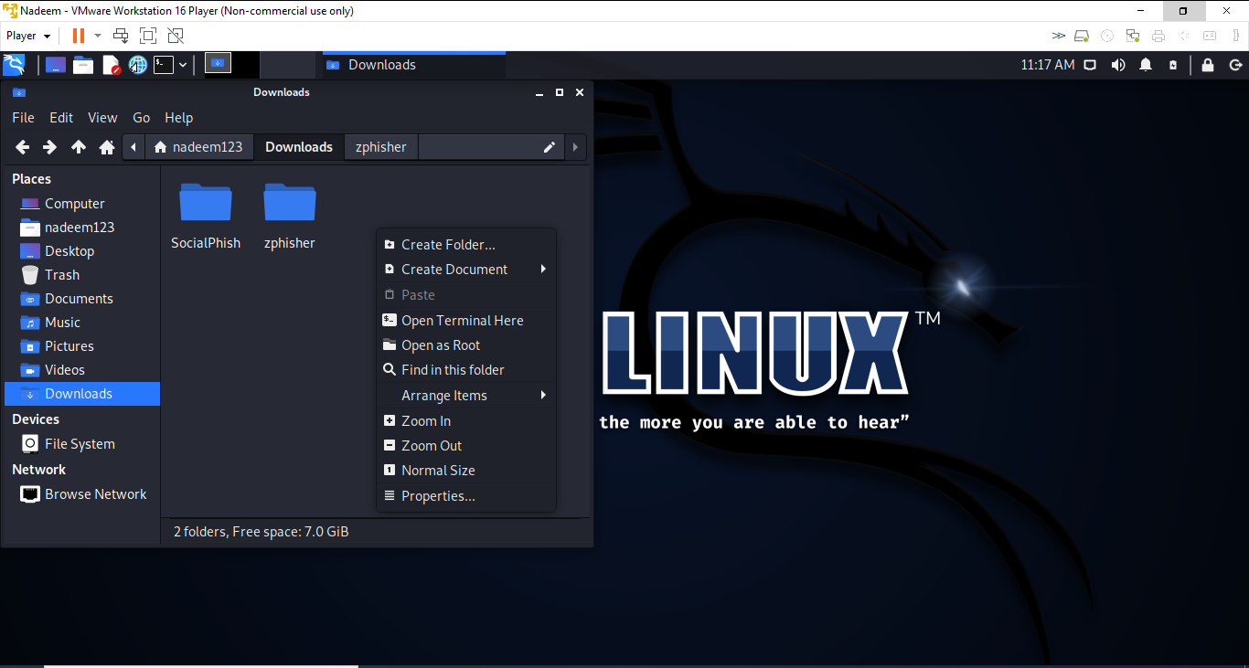
Opening Terminal

Slide 19
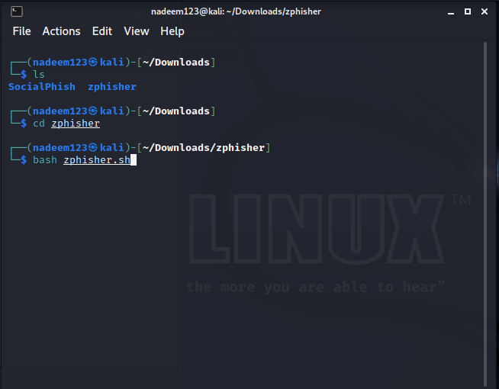
Writing Commands

Slide 20
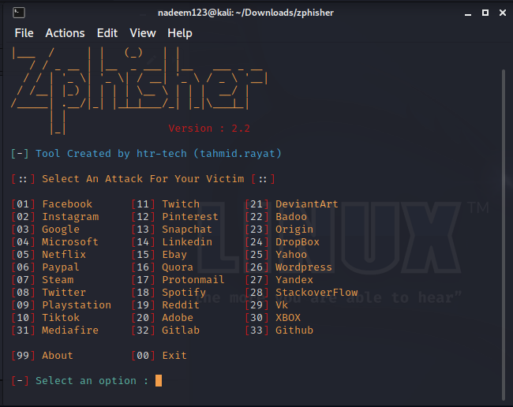
Selecting a platform

Slide 21
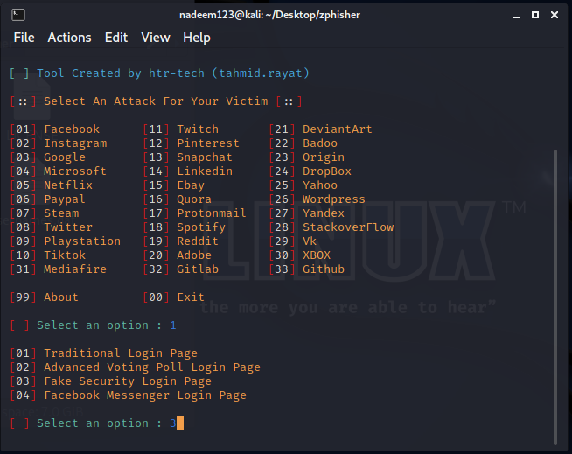
Selected the desired platform

Slide 22
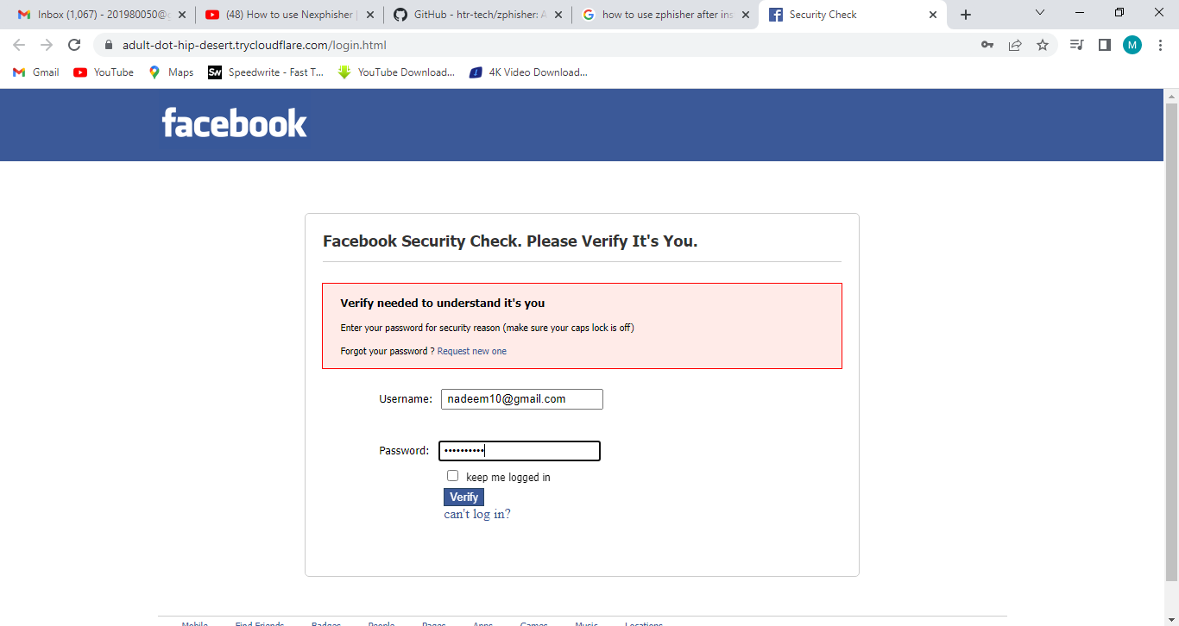

Slide 23
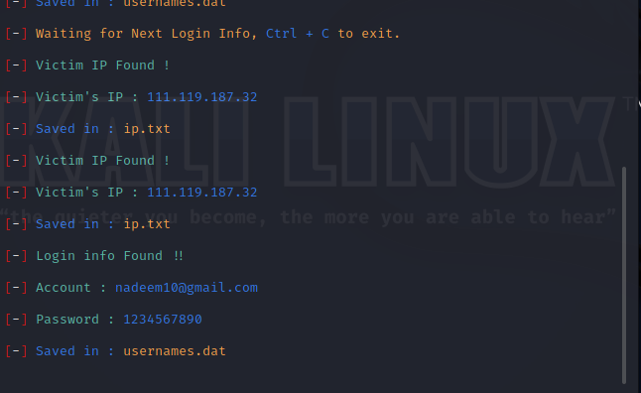

Slide 24
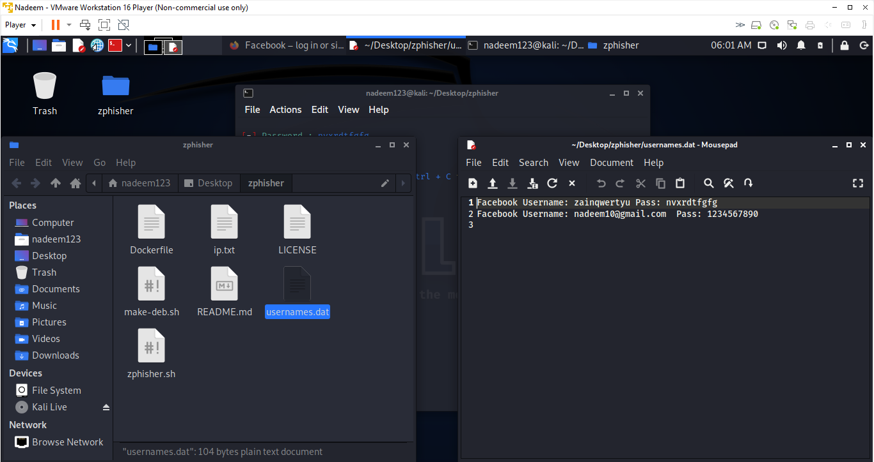

Slide 25
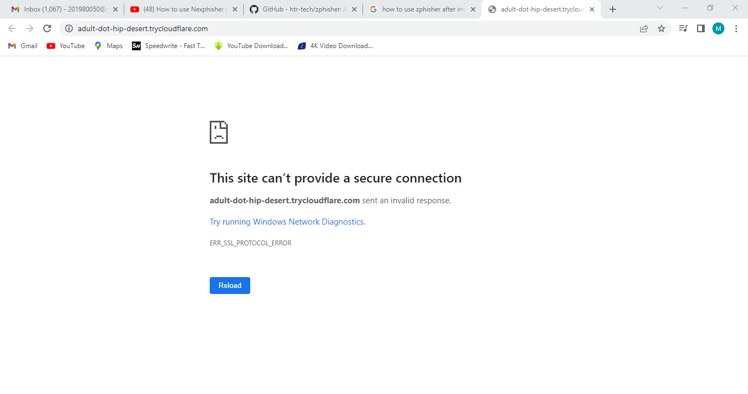

Slide 26
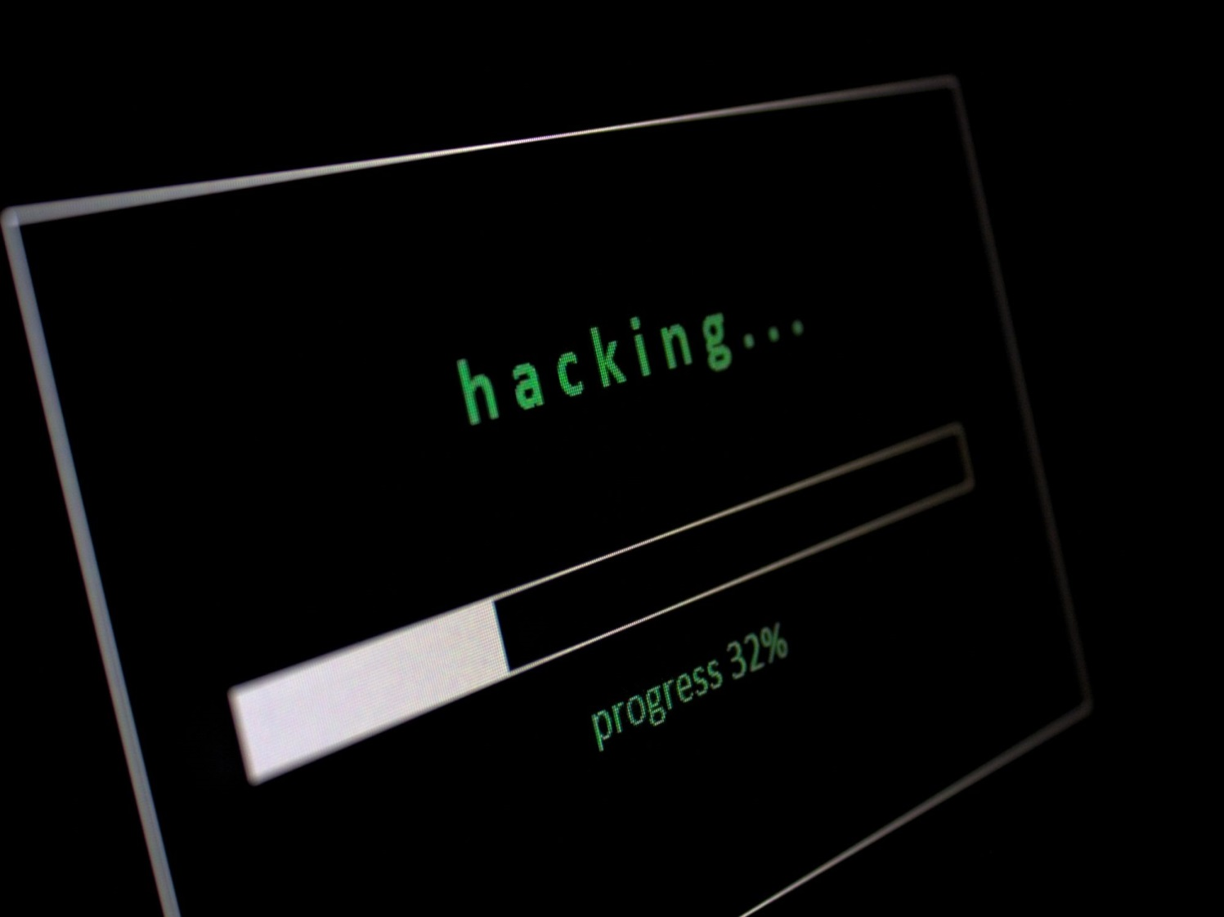
How phishing looks like?
Asking Personal Information
Attachments or links
Generic Greetings
Unrealistic Threats
A Sence of Urgency
From Government Agency
You are asked to send money
Spelling Errors & Poor grammar

Slide 27
Preventions/How to Avoid?
Never trust Alarming message
Keep your software and System updated
Avoid clicking embedded links
Use email filters
Examine website closely

Slide 28
Conclusion:
As the technology grows, the world is no longer in danger of bombs and missiles rather today’s world is more prone to the cyber threats. We need to keep ourselves updated according to current technological threats and security dangers. Only then we can move and thrive in today’s world.

Slide 29


